Slide 1
Election Data Study
Ellen Friedman
Sandy Martin
Luoyu Shen

Slide 2
Topics
Finding the Data
Transforming the Data
What we Learned from the Libraries Used
Other Learnings
Using Plotly
What It Is and Lessons Learned
Visuals we Created

Slide 3
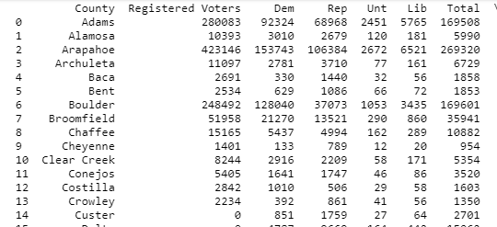
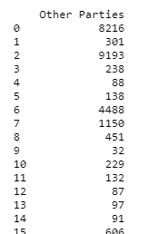
Transforming The Data for Colorado
Python Pandas & NumPy Modules
Pandas read csv→ DataFrame
Clean data
import pandas as pd
import numpy as np
def coData(df):
'''
:param df: a DataFrame of Colorado election data
'''
#Delete duplicate information rows
df = df.drop(['Total Votes', 'Total Votes.2', 'Total Votes.4', 'Total Votes.6'],1)
#rename party information
df_clear = df[:-1].rename({'Total Votes.1':'Dem', 'Total Votes.3':'Rep', 'Total Votes.5': 'Unt', 'Total Votes.7':'Lib'}, axis = 'columns’)
#incorporate Lib and Unt parties election result into Other parties
df_clear['Other Parties'] = df_clear[['Unt','Lib']].apply(np.sum, axis = 1)
counties = df_clear['County'][:-1]
#set bar chart colors
colors = ['rgb(255, 242, 230)', 'rgb(255, 204, 153)','rgb(255, 166, 77)’]
#pick up parties information
parties_election = df_clear.[['Rep', 'Dem', 'Other Parties']] parties_election_np = list(map(lambda x: np.array(df_clear[x]).tolist(),parties_election.columns))
return parties_election_np, counties, colors
def main():
#read Colorado csv
CO = pd.read_csv('CGGED.csv', header = 2)
#change it into DataFrame type
CO_df = pd.DataFrame(CO)
CO_elections, CO_counties, CO_colors = coData(CO_df)

Slide 4
Using Plotly
def draw_bar(parties_election, counties, colors, title):
'''
:param parties_election: a two-dimension list of parties' election results
:param counties: a list of counties\
:param colors: the colors of diffetent parties
:return: a bar chart
'''
parties = ['Replican', 'Democrat', 'Other parties’]
#use go.Bar to establish three traces and add them to data
data = [go.Bar(x = counties, y = party_election, name = party, marker = dict(color = color)) for party_election, party, color in zip(parties_election, parties, colors)]
#set layout
layout = go.Layout(
title= title,
xaxis = dict(tickangle = 45),
barmode = 'group'
)
#add fig
fig = go.Figure(data = data,
layout = layout)
# add state
py.plot(fig)
x and y axes value → bar chart
Built-in zip function → loop multiple lists
Layout & figure → set chart form
Notes:
Javascript is an object-oriented computer programming language commonly used to create interactive effects within web browsers.
A JavaScript library is a library of pre-written JavaScript which allows for easier development of JavaScript-based applications

Slide 5
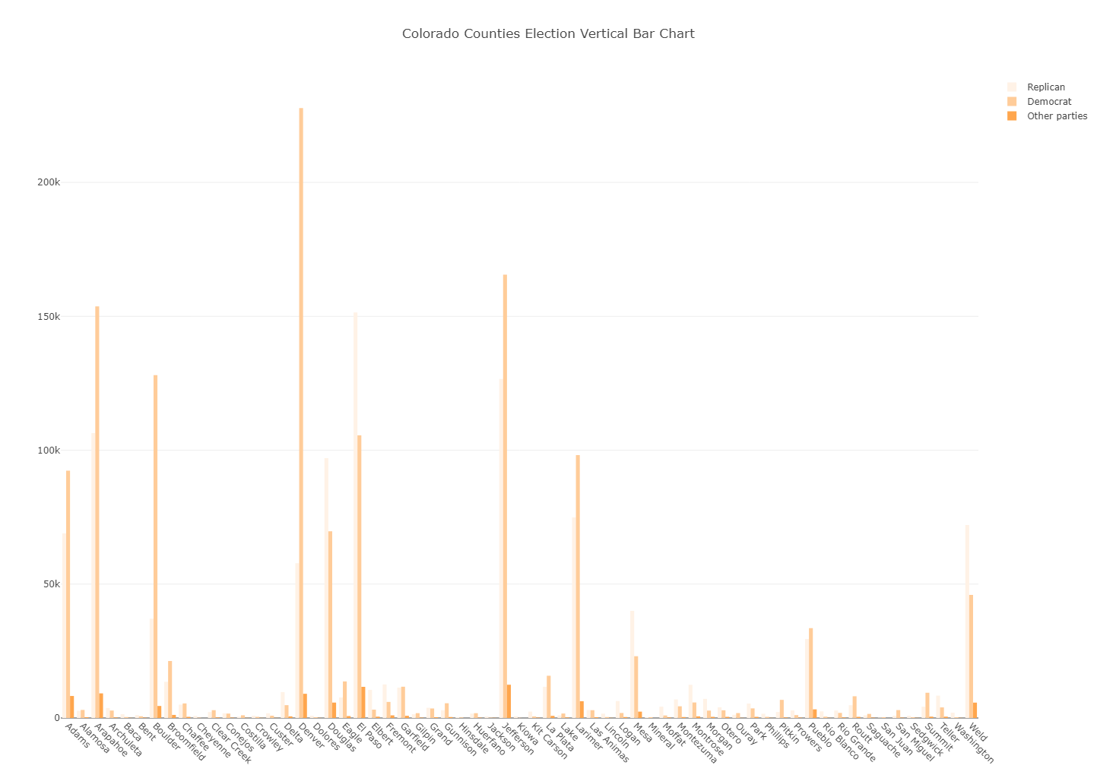
Using Plotly Vertical Bar Chart

Slide 6
Transforming The Data for Arizona
Used the Python CSV Library
Reader reads a line at a time and puts “cells” in a list
Ignores commas inside a cell
Easy to learn and use
from csv import reader def readElectionData (filename, county, red_cnt, blue_cnt, green_cnt): # Open the Excel file with the governor AZGovDataFile = open(filename,'r') # Line Count to skip the header line lineCount = 1 # Column Positions in the file ctyNamePos = 0 RepulicanPos = 3 DemocratPos = 4 GreenPartyPos = 5 # Loop through rows for aline in reader(AZGovDataFile): if lineCount <> 1 : county.append(aline[ctyNamePos]) red_cnt.append(aline[RepulicanPos]) blue_cnt.append(aline[DemocratPos]) green_cnt.append(aline[GreenPartyPos]) lineCount = lineCount + 1 AZGovDataFile.close()

Slide 7
Using Plotly
Easy to Install the main library. Supporting graph libraries can be a challenge
It’s a JavaScript library
It uses JSON to describe your visualizations
The JSON can be built using Python lists and dictionaries
def createBar (voteCounts, countyName, countyColor):
cLine = go.Bar(
y=['Repulican', 'Democrat', 'Other'],
x=[voteCounts[0], voteCounts[1], voteCounts[2]],
name=countyName,
orientation = 'h',
marker = dict(
color = [countyColor,countyColor,countyColor],
line = dict(
color = 'rgba(0, 0, 0, 1.0)',
width = 3)
)
)
return cLine
Notes:
Javascript is an object-oriented computer programming language commonly used to create interactive effects within web browsers.
A JavaScript library is a library of pre-written JavaScript which allows for easier development of JavaScript-based applications

Slide 8
Using Plotly Horizontal Bar Chart – MN Results

Slide 9
Transforming The Data for Minnesota
Original text file was at precinct level
Data needed to be collapsed to county level
Inserted FIPS codes for each county
Ready for Plotly map
def CollapsePrecincts(Precincts): # a collection of precincts sorted by county, precinct. # Collapse each precinct into its county and sum the votes. currentCountyName = "" dataLines = [] dataLine = [] for precinct in Precincts: if precinct['CountyName'] == currentCountyName: if precinct['Party'] == 'R': dataLine[4] += precinct['PartyVotes'] elif precinct['Party'] == 'DFL': dataLine[5] += precinct['PartyVotes'] else: dataLine[6] += precinct['PartyVotes']
FIPS,STATE,COUNTY,TOTAL_VOTES,R_VOTES,D_VOTES,O_VOTES
27001,Minnesota,Aitkin,8144,4481,3360,303
27003,Minnesota,Anoka,159282,75957,76234,7091
27005,Minnesota,Becker,14727,8784,5400,543
27007,Minnesota,Beltrami,17954,8328,8848,778
27009,Minnesota,Benton,16049,9406,6020,623
27011,Minnesota,Big Stone,2573,1353,1111,109
27013,Minnesota,Blue Earth,28135,10806,16317,1012
27015,Minnesota,Brown,11809,6461,4932,416
27017,Minnesota,Carlton,16312,6621,9051,640
27019,Minnesota,Carver,50856,26822,22334,1700
27021,Minnesota,Cass,13979,8145,5317,517
27023,Minnesota,Chippewa,5507,3008,2261,238
27025,Minnesota,Chisago,25773,14556,10090,1127
27027,Minnesota,Clay,24219,10301,12748,1170
27029,Minnesota,Clearwater,3467,2239,1125,103
27031,Minnesota,Cook,3191,1009,2054,128
27033,Minnesota,Cottonwood,5019,2843,2045,131
27035,Minnesota,Crow Wing,31310,18176,11866,1268

Slide 10
Using Plotly
Plotly maps rely on FIPS codes (Federal Information Processing Standards).
Import the plotly figure factory
Create a map by executing create_choropleth, and pass a set of lists, colors, bins, and other options.
Send your map to plotly.
myMap = ff.create_choropleth( fips=fips, values=vote_diffs, scope=states, county_outline={'color': 'rgb(192,192,192)', 'width': 0.5}, state_outline={'color': 'rgb(0,0,0)', 'width': 0.5}, binning_endpoints=[-0.3, -0.2,-0.1, 0, 0.1, 0.2, 0.3], legend_title='Margin of Difference per County', colorscale=blue_to_red)
Notes:
Javascript is an object-oriented computer programming language commonly used to create interactive effects within web browsers.
A JavaScript library is a library of pre-written JavaScript which allows for easier development of JavaScript-based applications

Slide 11
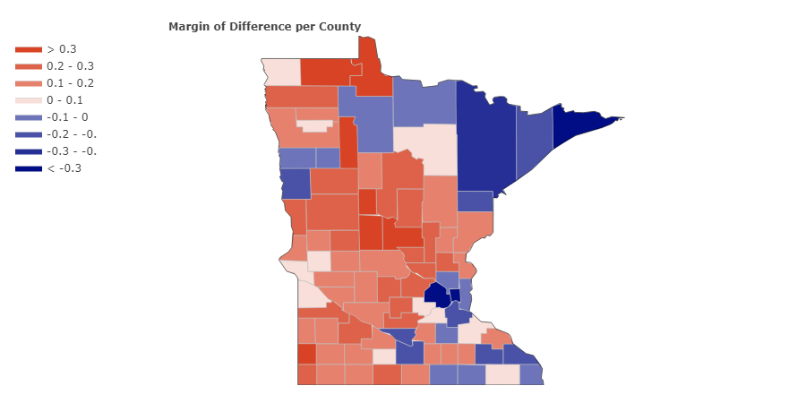
Using Plotly State Choropleth

Slide 12
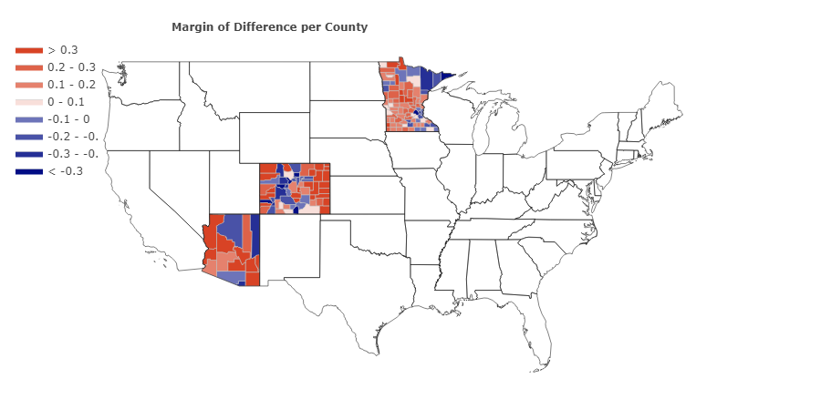
Using Plotly USA Choropleth

